Slide 1
Department of
Photography App
CS F212
BITS Pilani
Apr 17, 2024

Slide 2
Project Description
The Department of Photography App aims to aid in the effective collection, storage, and efficient distribution of photos taken of students by members of the Department of Photography. The Department of Photography is a team of 25 members that click an average of 3 lakh pictures over the course of each fest.
The system consists of a front-end user interface and a back-end database system to keep track of photos taken of students during fests, snaps, and other events. The database system will store information about students, like their hostel rooms, club and department memberships, authorisations, and dues for photos. The user interface will allow for easy access to stored information, allowing quick distribution of photos by Department of Photography members, easy viewing of snaps and dues by students, and effortless altering of club/department members by coordinators.

Slide 3
Features
Storing and fetching student information
This system stores the names, BITS IDs, hostel rooms, room numbers, and email addresses, which are derived from the BITS IDs through an SQL query.
Viewing photographs
A student can view all the photographs they are featured in in one place through an SQL query. A student is also allowed to view the snapshots of the clubs and/or departments they are a member of. A snapshot is categorized as a club or department picture at the time of entering the photograph in the database.

Slide 4
Features
3. Generating bills
Each student will receive a bill, generated by calculating the sum of costs from each photograph they have been tagged in, through a simple query.
4. Managing access
Department of Photography members (admin members) get full access to the database for editing and viewing of records. They will be able to see a Camera Log and Photo Log through the Control Desk.

Slide 5
Features
5. Tagging photographs
Each photograph will be “tagged” with the BITS ID of the students present in the picture, ensuring that the student can view their photographs. This is also to ensure that due collection and distribution can be easily managed. Tagging can be done only by the admin members.

Slide 6
Features
6. Control Desk
The system will also log Department of Photography members’ work, such as who is currently working, with which camera, and on which roll. This control desk will be accessible to the admin members, who will be able to see two lists. The first will be a camera list containing a list of every camera and the most recent photograph clicked with the camera, alongside details of the timestamp at which it was last used, and the clicker’s ID. The second will be a list of all the photographs taken by the Department of Photography members, including photo_id, clicker_id, detailer_id, date_time, roll_no, frame_no, file_address, and camera_id. The admin members will be able to access the tagging screen for every photograph individually.

Slide 7
Features
7. Managing Deliveries
The admin members will be responsible for making a delivery schedule, including the Department of Photography members, and which hostels and room numbers they will deliver the photographs to. This will be fed into the database by the admin and all the admin members will be able to access this table.
8. Special access for club/department heads
A student will be able to access the records for whichever club or department they are a coordinator of. Coordinators of clubs and departments will have the authority to add and remove members from their respective clubs/departments.

Slide 8
Tools Used
SQL: Backend
JavaSwing: GUI
Lucid: ER Diagram, Relational Model

Slide 9
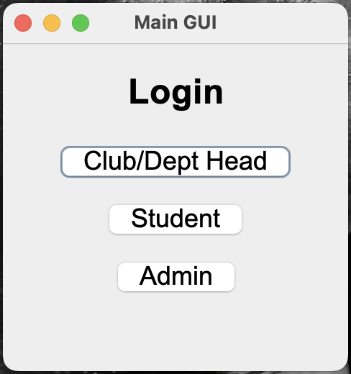
Login

Slide 10
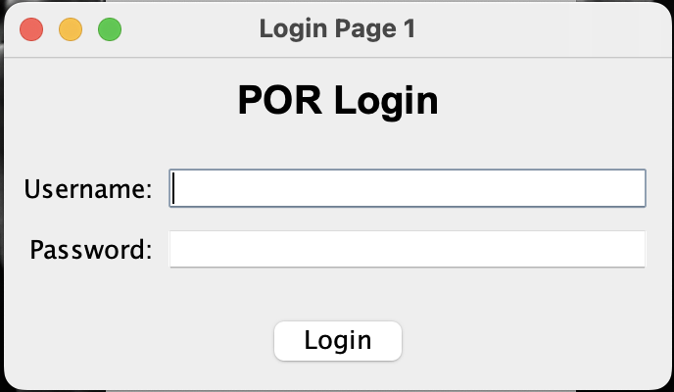
POR Login

Slide 11
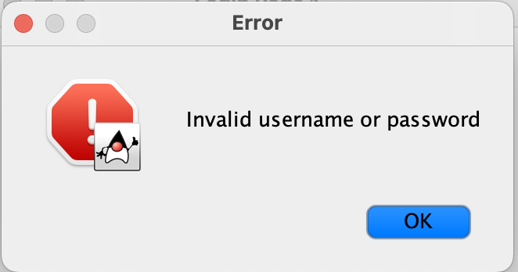
Wrong Password Entered

Slide 12
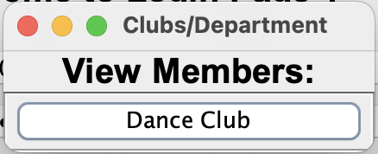
View Members

Slide 13
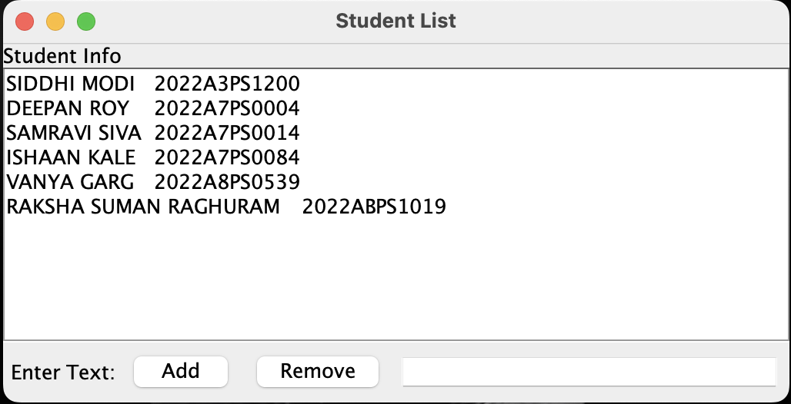
Member List

Slide 14
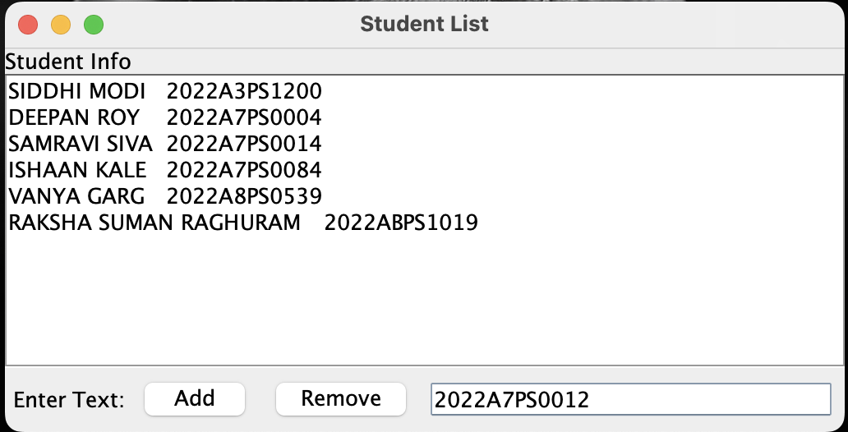
Adding Members

Slide 15
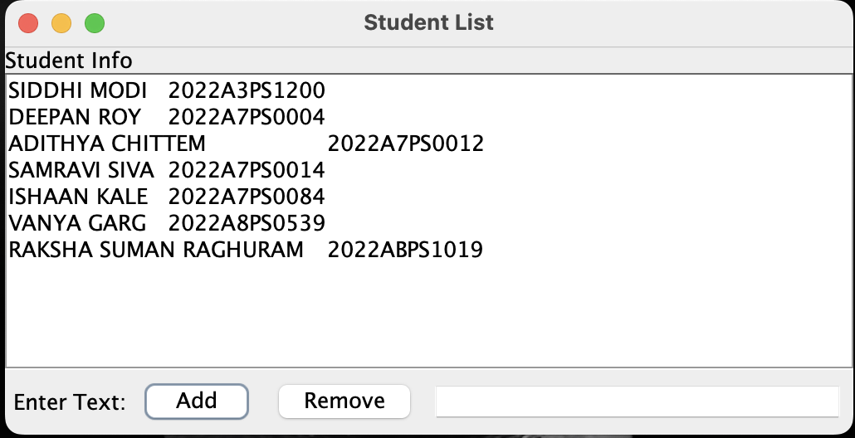
Added Members

Slide 16
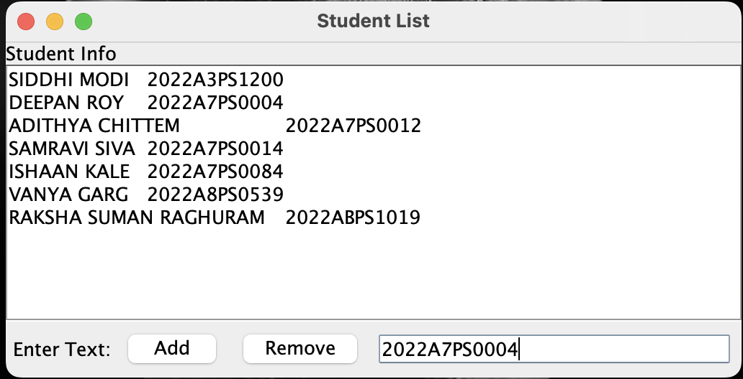
Removing Members

Slide 17
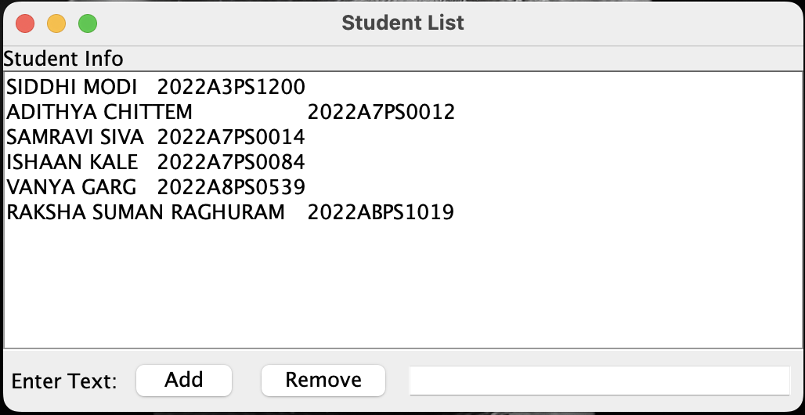
Removed Members

Slide 18
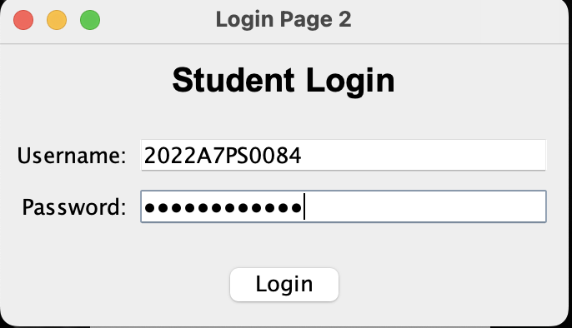
Student Login

Slide 19
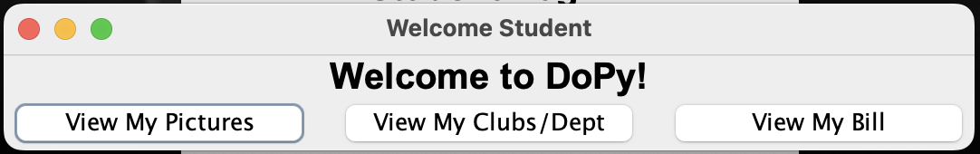
Student Page

Slide 20
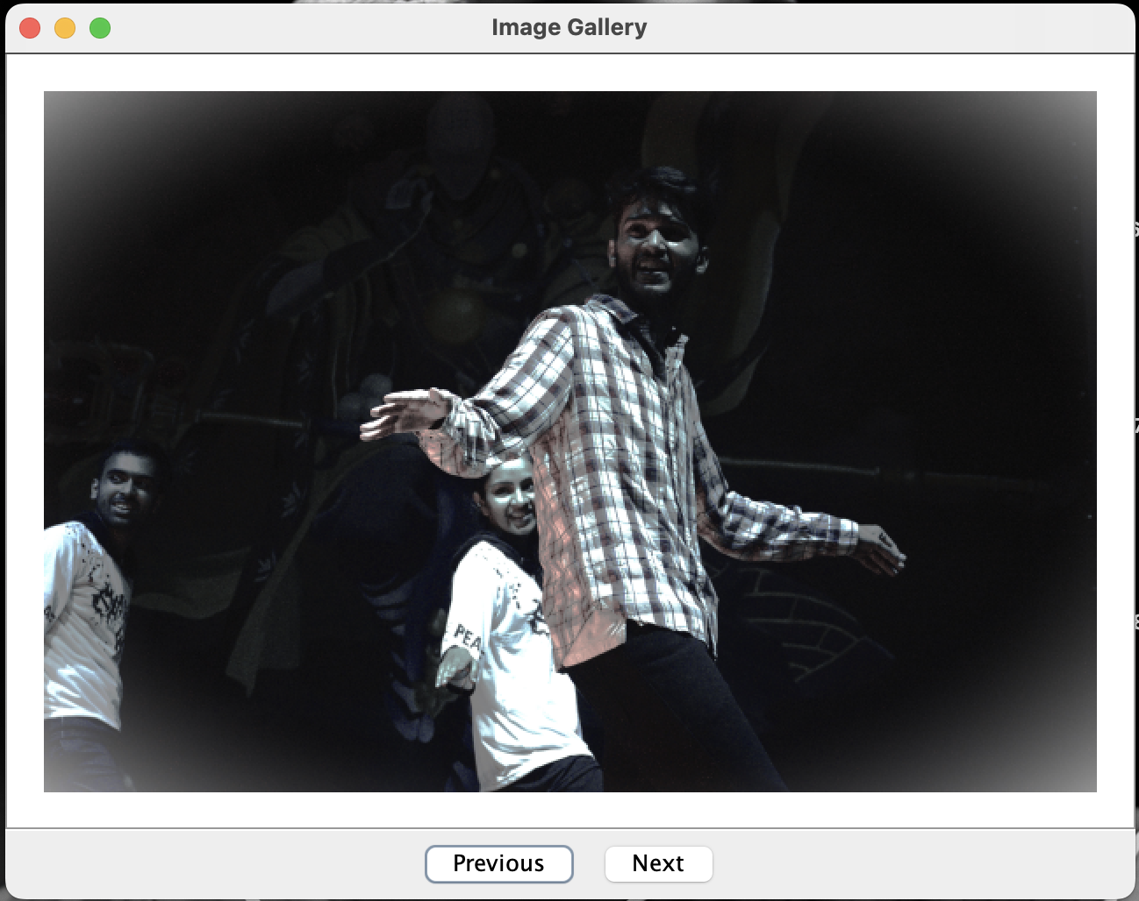
View pictures

Slide 21
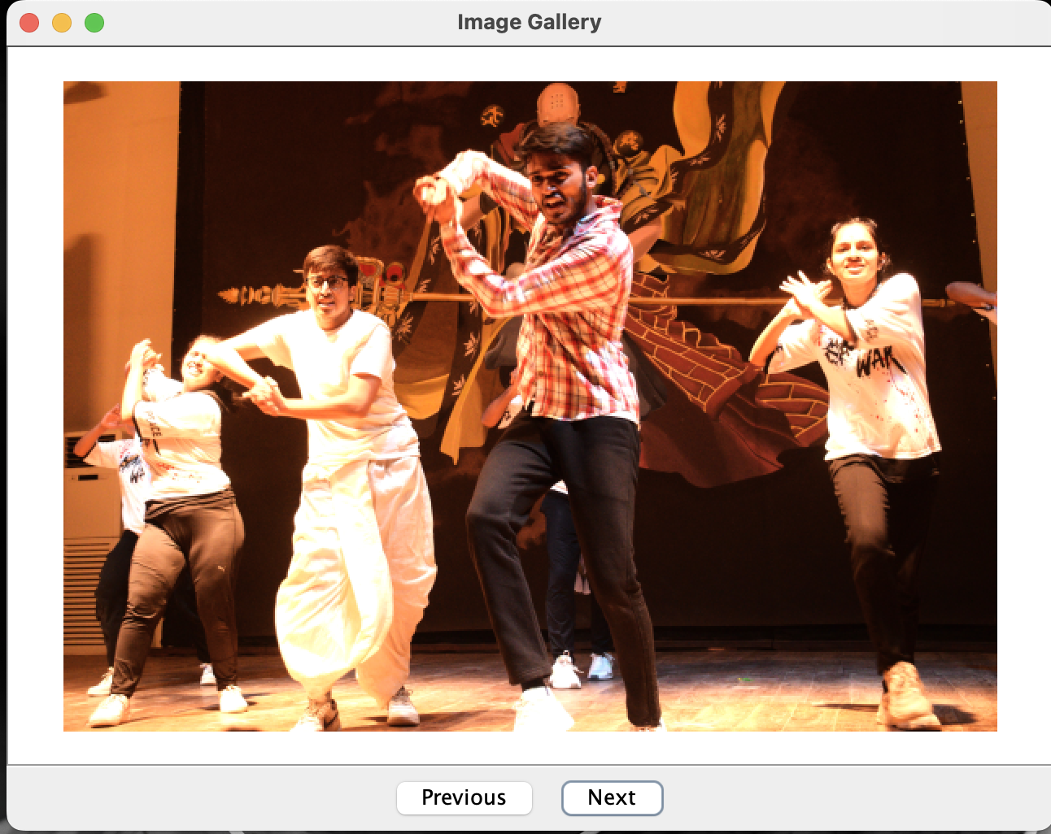
View Next Picture

Slide 22
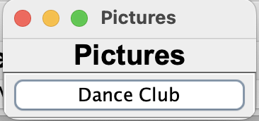
View my clubs/ departments

Slide 23
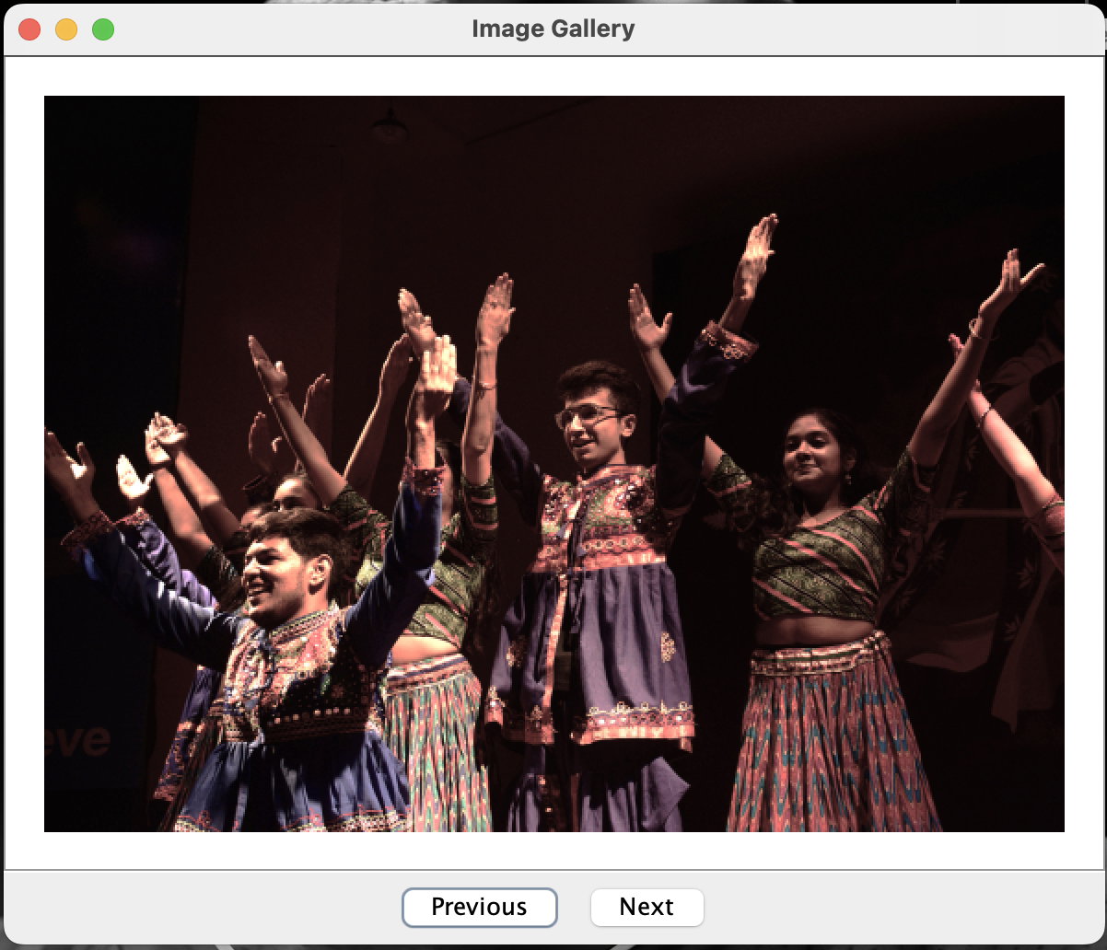
Viewing my club/ department’s picture

Slide 24
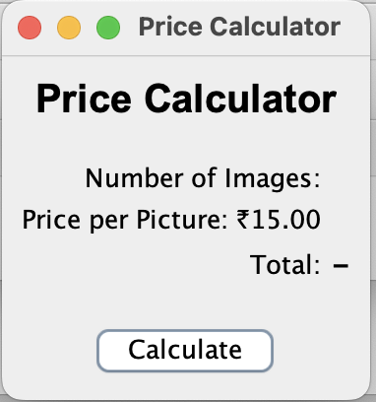
Bill Calculator

Slide 25
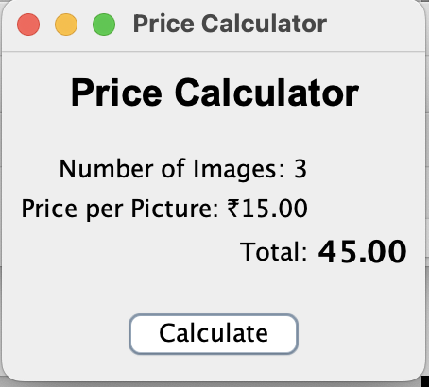
Bill after Calculating

Slide 26
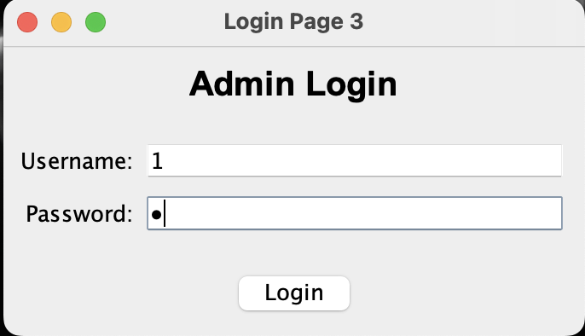
Admin Login

Slide 27
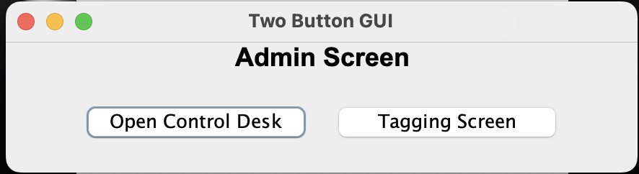
Admin Screen

Slide 28
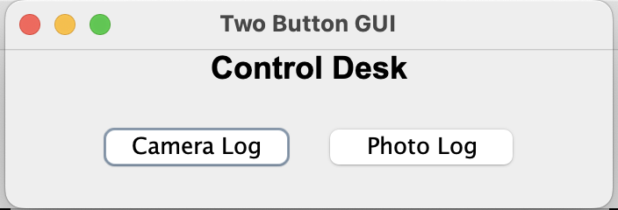
Control Desk

Slide 29
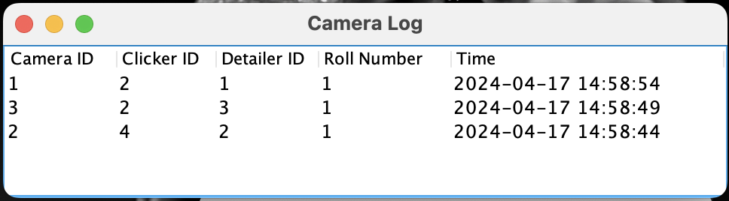
Camera Log

Slide 30
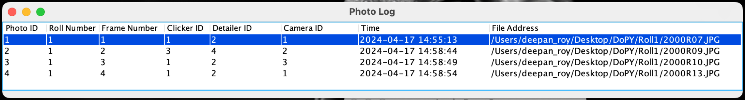
Photo Log

Slide 31
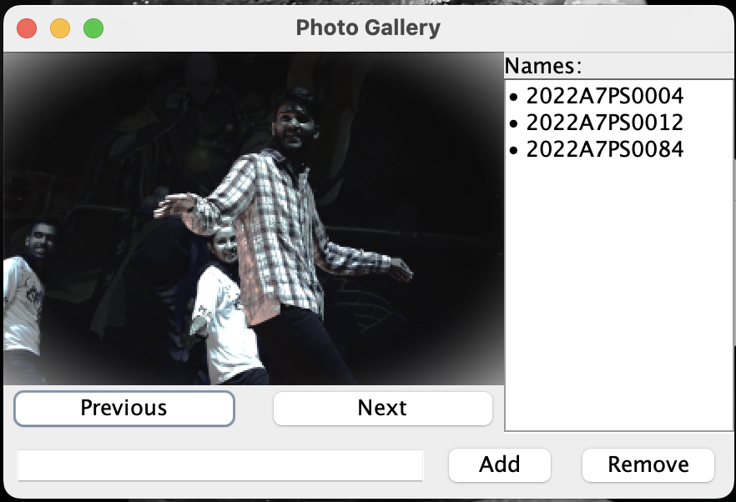
Tagging Screen

Slide 32
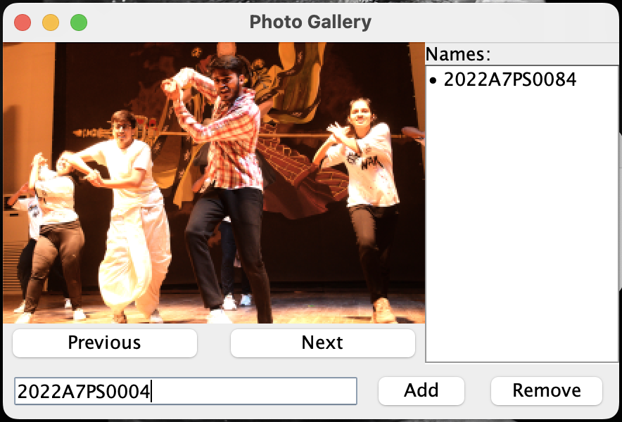
Adding Entry

Slide 33
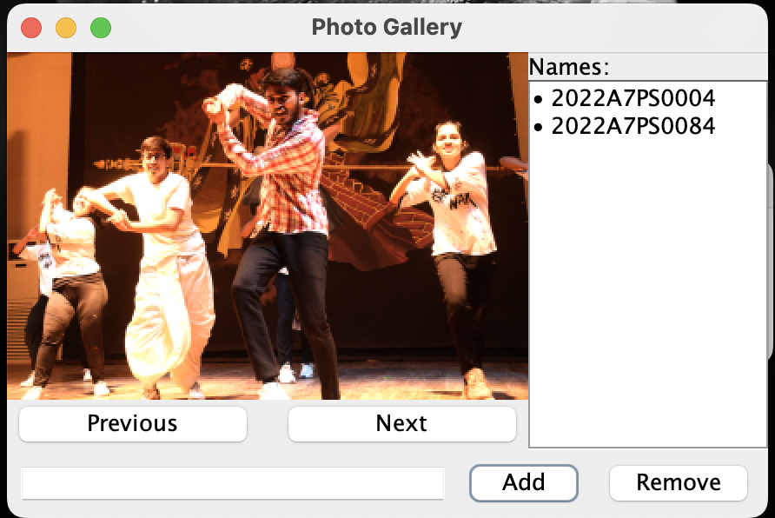
Entry Added

Slide 34
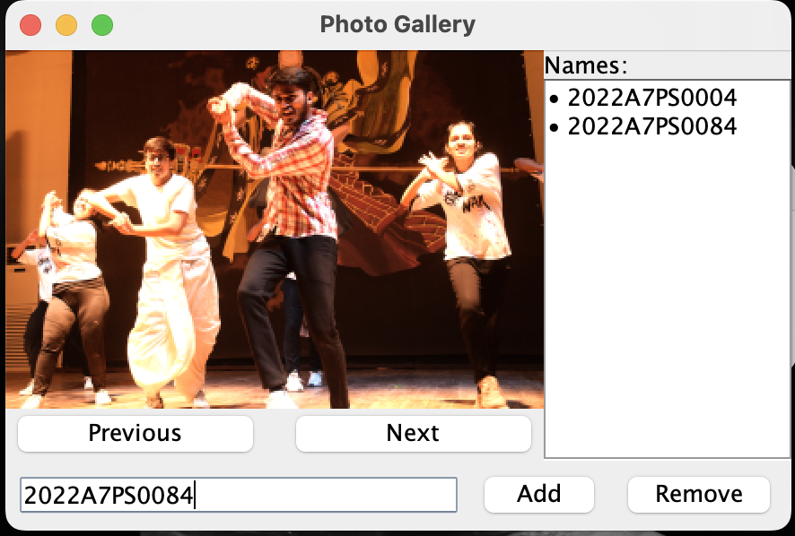
Removing Entry

Slide 35
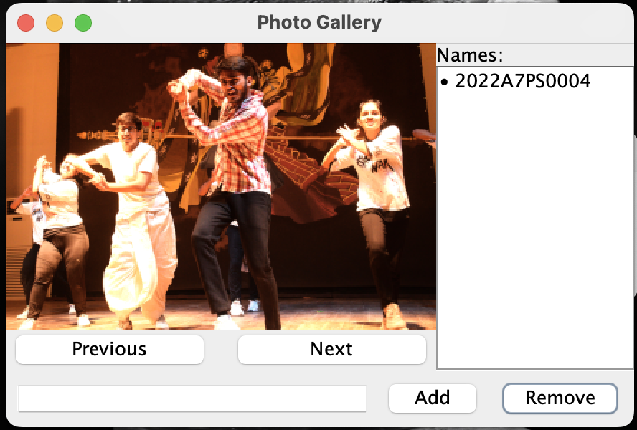
Entry Removed

